Slide 1

Fundamental Concepts Of Data Security
Introduction

Slide 2
COMMONWEALTH OF AUSTRALIA
Copyright Regulation 1969
WARNING
This material has been copied and communicated to you by
or on behalf of Curtin University of Technology pursuant
to Part VB of the Copyright Act 1968 (the Act)
The material in this communication may be subject to
copyright under the Act. Any further copying or
communication of this material by you may be the
subject of copyright protection under the Act.
Do not remove this notice

Slide 3
Unit Objectives
Key concepts and approaches that are fundamental to data security
Detailed coverage of major aspects of data security
security goals and general approaches to protecting data and information
security controls (administrative, physical, technical)
business continuity
ethics
Notes:
Today, we're diving into the core of our data security unit. This slide lays out our roadmap. We're going to cover the main ideas that underpin data security, get into the details, talk about how we protect our data, and even touch on the ethical side of things.

Slide 4
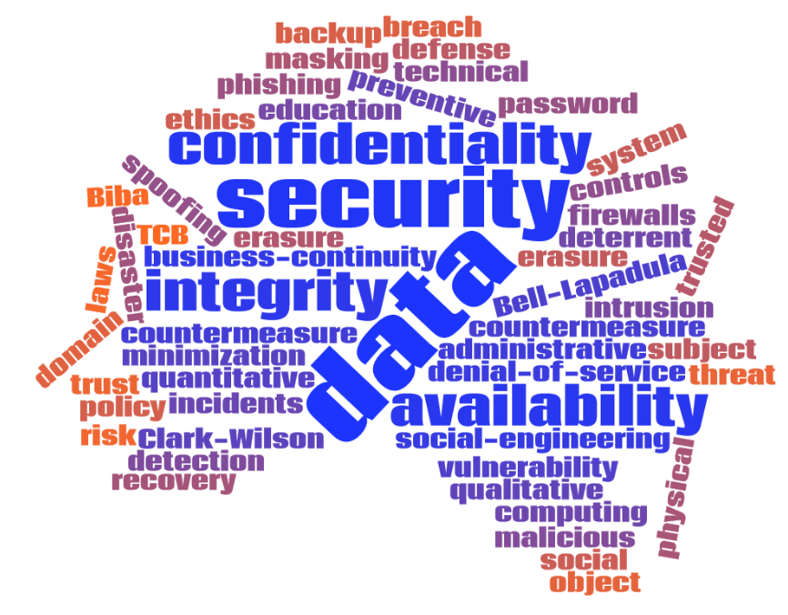
Notes:
Here is the word cloud of topics covered in the unit

Slide 5
Introduction
Topics to explore
what is security and how it has changed over time
what is needed to have an effective security system
what are the principles of security
what are the broad guidelines in terms of past security standards
Security policy and procedures
information classification
education
risk analysis

Slide 6

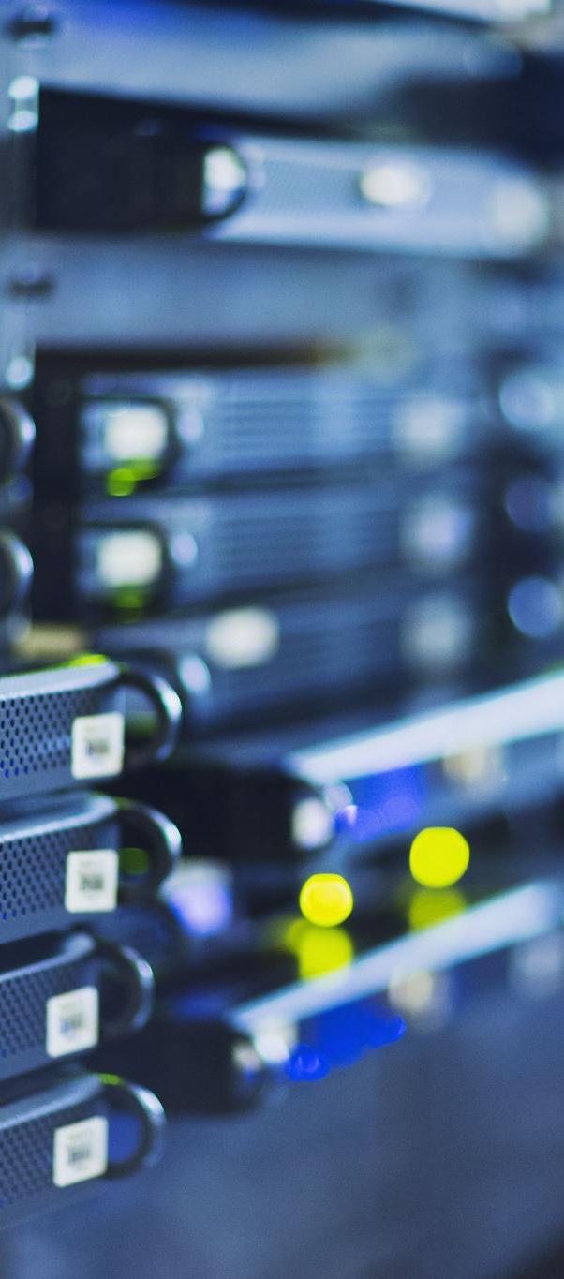
What is data security?
Data: information
Data security
Practice of protecting information
Mitigate risks
Balanced approach: confidentiality, integrity, availability
Notes:
From Wikipedia: https://en.wikipedia.org/wiki/Information_security
Information security, sometimes shortened to infosec, is the practice of protecting information by mitigating information risks. It is part of information risk management. It typically involves preventing or at least reducing the probability of unauthorized/inappropriate access, use, disclosure, disruption, deletion/destruction, corruption, modification, inspection, recording or devaluation, although it may also involve reducing the adverse impacts of incidents. Information may take any form, e.g. electronic or physical.,^{[1]} tangible (e.g. paperwork) or intangible (e.g. knowledge). Information security's primary focus is the balanced protection of the confidentiality, integrity and availability of data (also known as the CIA triad) while maintaining a focus on efficient policy implementation, all without hampering organization productivity.^{[2]} This is largely achieved through a structured risk management process that involves:
Identifying information and related assets, plus potential threats, vulnerabilities and impacts;
Evaluating the risks;
Deciding how to address or treat the risks i.e. to avoid, mitigate, share or accept them;
Where risk mitigation is required, selecting or designing appropriate security controls and implementing them;
Monitoring the activities, making adjustments as necessary to address any issues, changes and improvement opportunities.

Slide 7
Information Systems
Six components
Data: database records, files, documents…
Software: applications, operating systems…
Hardware: server, UPS, usb devices…
Network: cables, routers, LANs, WiFi…
People/Users: administrators, normal users…
Procedures: security policies, continuity plans, incident response plans…
Notes:
From Principles of Information Security
An information system (IS) is much more than computer hardware; it is the entire set of software, hardware, data, people, procedures, and networks that make possible the use of information resources in the organization. These six critical components enable information to be input, processed, output, and stored. Each of these IS components has its own strengths and weaknesses, as well as its own characteristics and uses. Each component of the information system also has its own security requirements.

Slide 8
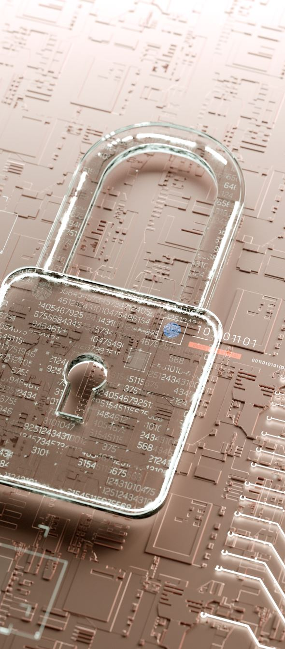
Historical Perspective
Security used to be much different
Systems used to be tightly controlled and were centralised
Access to the system was limited
Access to information was easier to check and review
Modern security is much more challenging
information is often sent via unsecured channels
computing equipment is more diverse and thus integration is always a key security issue
more threats to be addressed when being online
Notes:
Security management has changed over the years because networked environments, computers, and the applications that hold information have changed. Information used to be held in a mainframe, which is a more centralized network structure. The mainframe and management consoles used to access and configure the mainframe were placed in a centralized area instead of having the distributed networks we see today. Only certain people were allowed access, and only a small set of people knew how the mainframe worked, which drastically reduced security risks. Users were able to access information on the mainframe through “dumb” terminals (they were called this because they had little or no logic built into them). There was not much need for strict security controls to be put into place. However, the computing society did not stay in this type of architecture. Now, most networks are filled with personal computers that have advanced logic and processing power; users know enough about the systems to be dangerous; and the information is not centralized within one “glass house.” Instead, the information lives on servers, workstations, and other networks. Information passes over wires and airways at a rate not even conceived of 10 to 15 years ago.
The Internet, extranets (business partner networks), and intranets not only make security much more complex, but they also make security even more critical. The core network architecture has changed from being a localized, stand-alone computing environment to a distributed computing environment that has increased exponentially with complexity. Although connecting a network to the Internet adds more functionality and services for the users and expands the company’s visibility to the Internet world, it opens the floodgates to potential security risks.

Slide 9
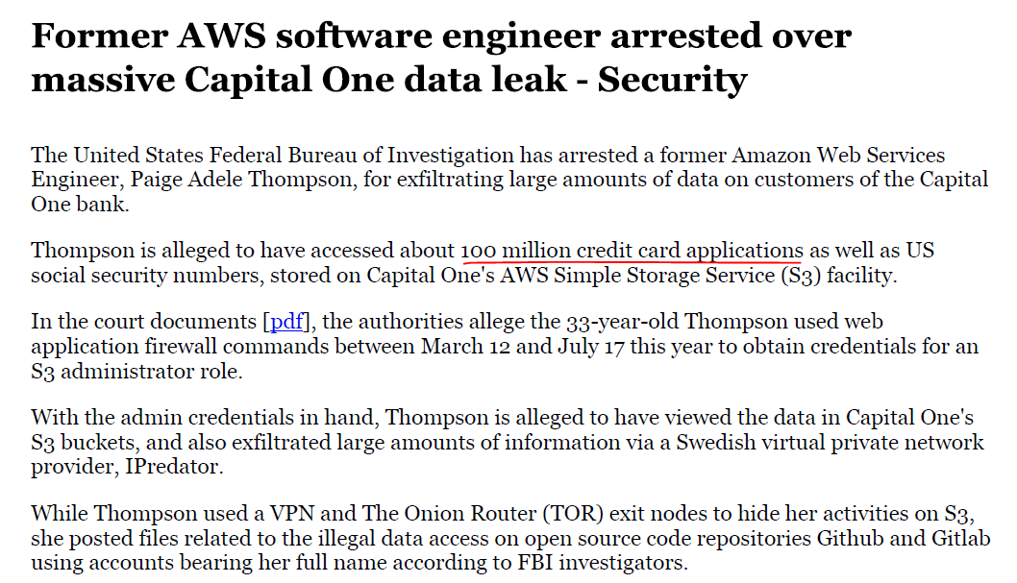
Why Data Security?
Source: https://www.itnews.com.au/news/former-aws-software-engineer-arrested-over-massive-capital-one-data-leak-528853
Notes:
Here are some recent examples of data breach
Capital One Data Leak 2019
Source: https://www.itnews.com.au/news/former-aws-software-engineer-arrested-over-massive-capital-one-data-leak-528853

Slide 10
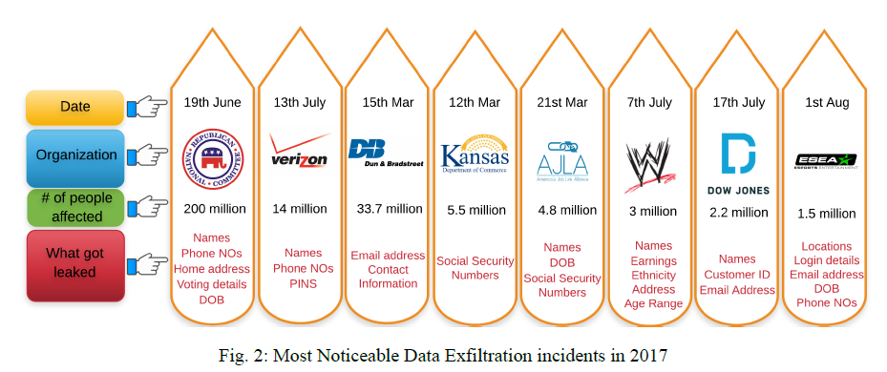
Why Data Security?
F. Ullah, R. Ramdhany, M. Edwards, and R. Chitchyan. Data Exfiltration: A Review of External Attack Vectors and Countermeasures. Journal of Network and Computer Applications · November 2017
Notes:
Here are some recent examples of data breach
Data Exfiltration: A Review of External Attack Vectors and Countermeasures
By F. Ullah, R. Ramdhany, M. Edwards, and R. Chitchyan
Journal of Network and Computer Applications · November 2017
https://www.researchgate.net/publication/320803746

Slide 11
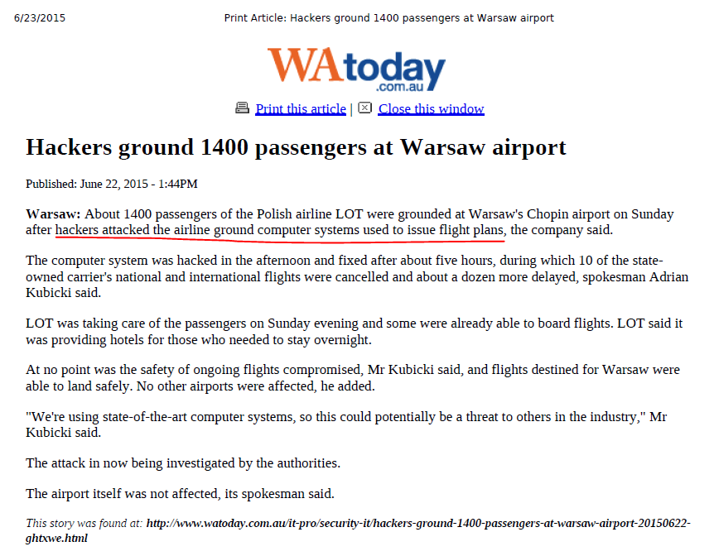
Why Data Security?
Source: http://www.watoday.com.au/itpro/securityit/hackersground1400passengersatwarsawairport20150622ghtxwe.html
Notes:
Airport Hack Example
http://www.watoday.com.au/itpro/securityit/hackersground1400passengersatwarsawairport20150622ghtxwe.html

Slide 12
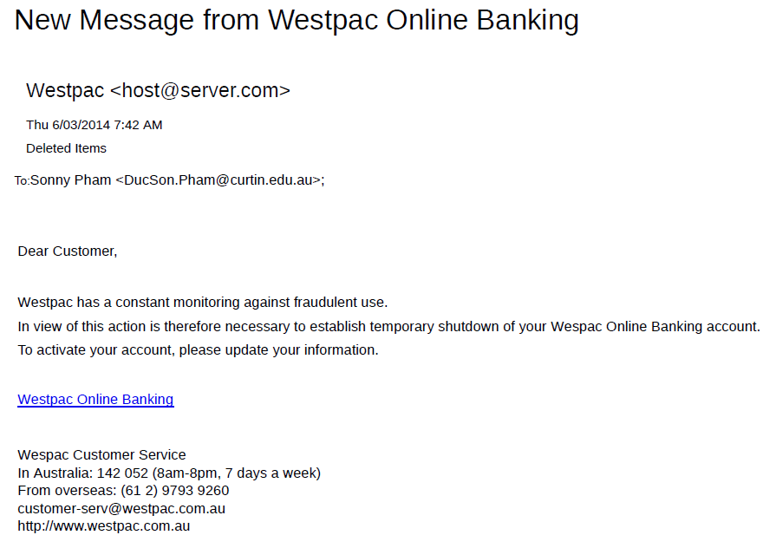
Why Data Security?
Notes:
Phishing example that you may come across

Slide 13
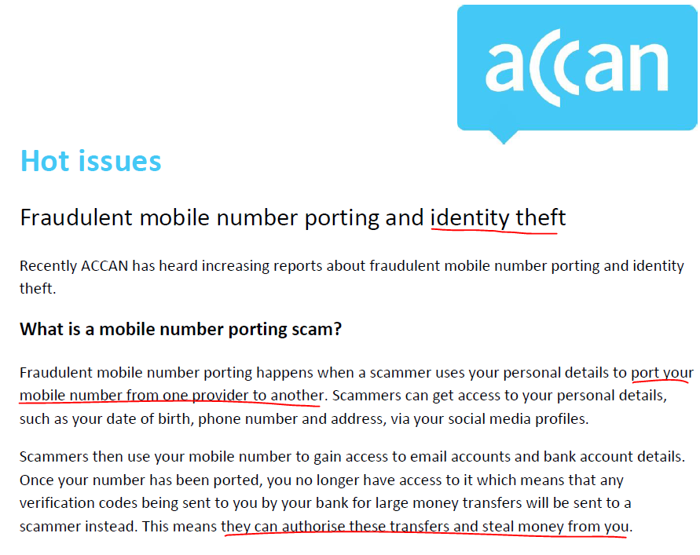
Why Data Security?
Source: https://accan.org.au/hot-issues/1385-fraudulent-mobile-number-porting-and-identity-theft
Notes:
Identity theft
https://accan.org.au/hot-issues/1385-fraudulent-mobile-number-porting-and-identity-theft

Slide 14
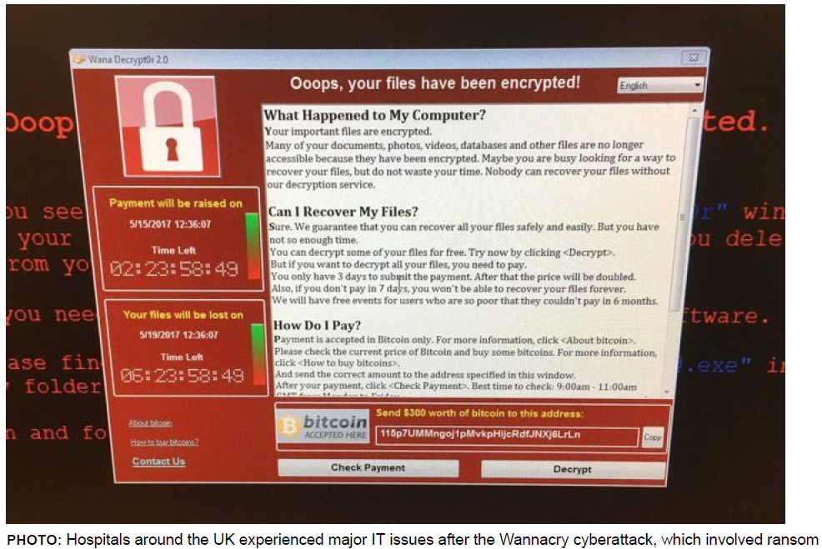
Why Data Security?
Source:https://www.abc.net.au/news/2019-07-08/microsoft-windows-vulnerability-bluekeep-and-cyber-security-risk/11277270
Notes:
Ransomware Attacks
Screenshot in the WannaCry ransomware attack
Source: https://www.abc.net.au/news/2019-07-08/microsoft-windows-vulnerability-bluekeep-and-cyber-security-risk/11277270

Slide 15
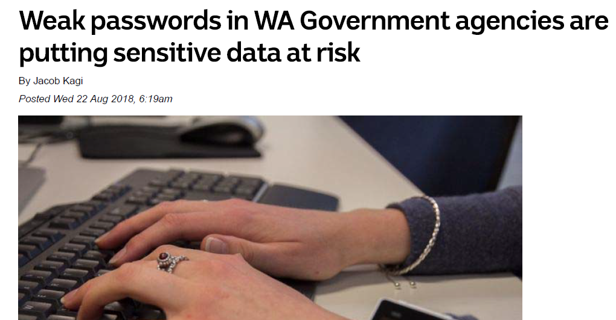
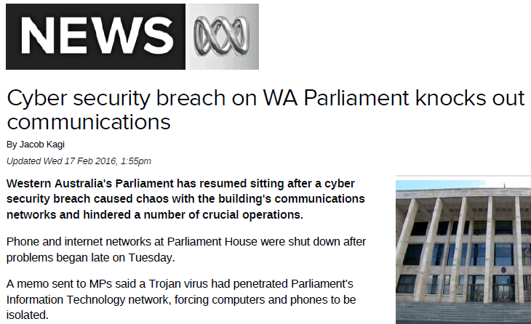
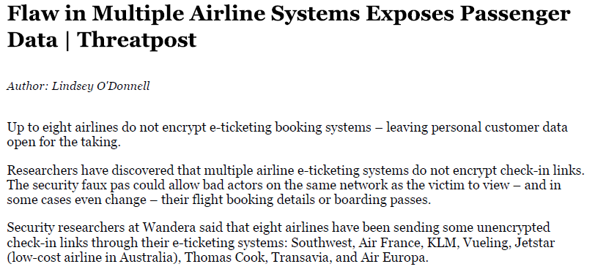
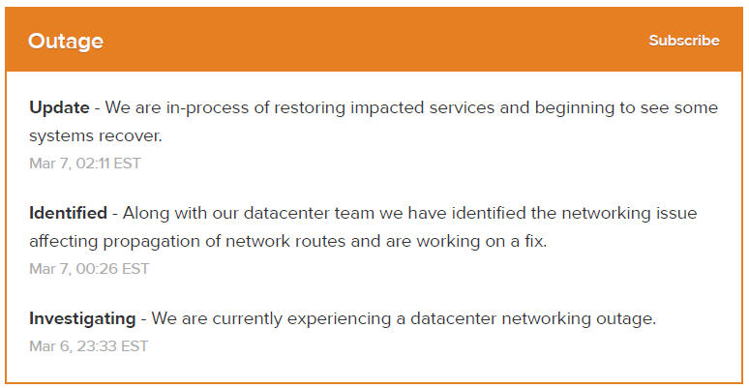
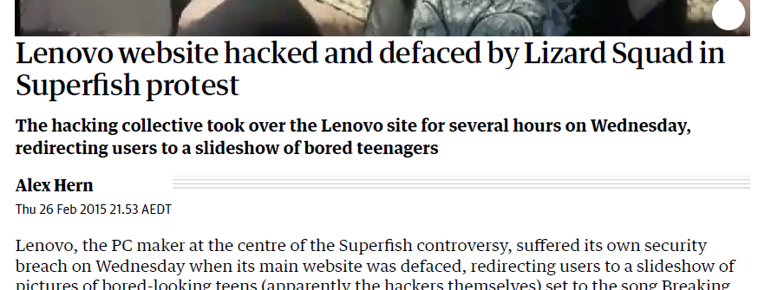
Why Data Security?
Notes:
Many other examples in the media
Weak passwords
WA Parliament hack
Lenovo web deface
Bit.ly outage
Insecure online checkin

Slide 16
Syllabus
This unit will cover the key aspects of data security from the point of view the three underpinning security principles: Confidentiality, Integrity and Availability.
The content will cover the extension of the fundamental model CIA and will introduce the key concepts of risk management in an information security context.
Data security can be provided through a range of controls and technologies which will be covered in detail. This will include administrative, physical and logical controls as well the processes required to handle incidents, change management and business continuity (and disaster planning and recovery).
Finally, the unit will cover data backups, data masking/encryption and data erasure that is compliant with international standards.

